Slide 1
Software Development with UML and Java 2
Adapter

Slide 2
Agenda: Adapter design pattern
Concept of an adapter
Introduction to software adapter by a problem
Defining the adapter pattern
Common use in semester project, database
Adapting a List to a Queue, for the assignment
Further reading
At 10:15 we’ll do the Proxy

Slide 3
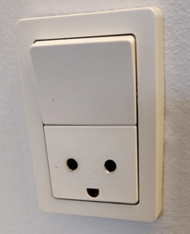
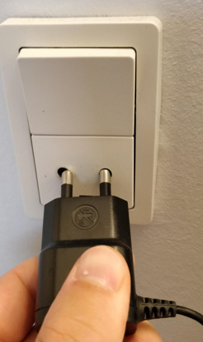
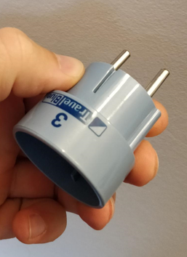
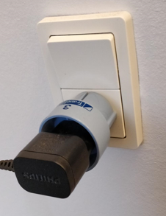
What is an adapter?
Notes:
In the physical world, an adapter is usually something that connects to parts, which doesn’t otherwise fit together. Here is shown the power plug for something I bought from the Netherlands. It doesn’t fit into the Danish sockets.
Using my pretty, blue adapter, I can plug it into the socket.

Slide 4
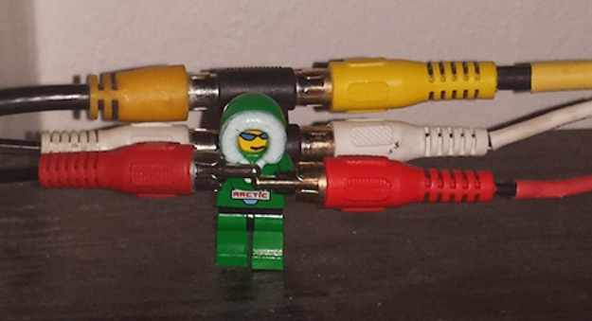
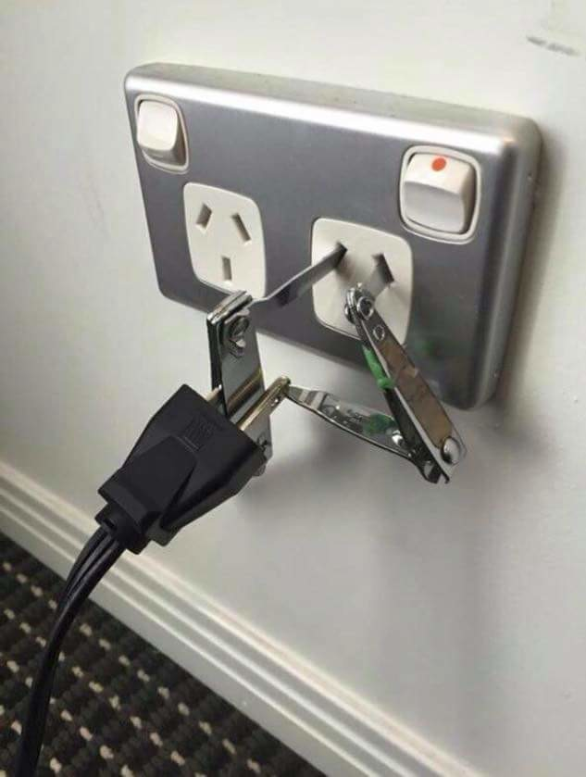

What is an adapter?
Notes:
You can go overboard

Slide 5
Conceptual idea

Slide 6
Pre-condition: You are maintaining an existing system that makes use of a third-party class library from vendor A
Event: Vendor A goes belly up and corporate policy does not allow you to make use of an unsupported class library
This could e.g. be Prostgres, and the Driver used to connect to the DB
Existing
System
Component
From
Vendor A
Notes:
Green part represents an existing system, with all kinds of classes and whatnot. Your system is using some functionality that you got from somewhere else, the internet or whatever. This is the Orange.
The common example in SEP2 is that you use a Postgres Jar file, with functionality to connect to a Postgres database.
If Postgres goes bankrupt, and stops supporting their driver, you’re in trouble.

Slide 7
Pre-condition: You are maintaining an existing system that makes use of a third-party class library from vendor A
Event: Vendor A goes belly up and corporate policy does not allow you to make use of an unsupported class library
Response: Vendor B provides a similar class library, with equal functionality, but its interface is completely different from the interface provided by vendor A
Existing
System
Component
From
Vendor B
Component
From
Vendor A
Notes:
Some other provider has a similar database, also with a Jar file with the functionality to connect to their database. But the methods are not called the same as what your system previously used. So the new functionality doesn’t immediately fit into your system

Slide 8
Pre-condition: You are maintaining an existing system that makes use of a third-party class library from vendor A
Event: Vendor A goes belly up and corporate policy does not allow you to make use of an unsupported class library
Response: Vendor B provides a similar class library, with equal functionality, but its interface is completely different from the interface provided by vendor A
Assumptions: You don’t want to change your code, and you can’t change vendor B’s code
Existing
System
Component
From
Vendor B

Slide 9
Response: Vendor B provides a similar class library but its interface is completely different from the interface provided by vendor A
Pre-condition: You are maintaining an existing system that makes use of a third-party class library from vendor A
Assumptions: You don’t want to change your code, and you can’t change vendor B’s code
Event: Vendor A goes belly up and corporate policy does not allow you to make use of an unsupported class library
Solution?: Write new code that adapts vendor B’s interface to the interface expected by your original code
Existing
System
Component
From
Vendor B
Adapter

Slide 10
Response: Vendor B provides a similar class library but its interface is completely different from the interface provided by vendor A
Pre-condition: You are maintaining an existing system that makes use of a third-party class library from vendor A
Assumptions: You don’t want to change your code, and you can’t change vendor B’s code
Event: Vendor A goes belly up and corporate policy does not allow you to make use of an unsupported class library
Solution?: Write new code that adapts vendor B’s interface to the interface expected by your original code
Existing
System
Adapter
Component
From
Vendor B
Component
From
Vendor A
Notes:
We introduce a class, which implements the interface of your existing system. This class then uses and manages access to the component from Vector B.
The Adapter class can be said to translate from one method to another. It creates a bridge between your system and the Vendor B component

Slide 11
Response: Vendor B provides a similar class library but its interface is completely different from the interface provided by vendor A
Pre-condition: You are maintaining an existing system that makes use of a third-party class library from vendor A
Assumptions: You don’t want to change your code, and you can’t change vendor B’s code
Event: Vendor A goes belly up and corporate policy does not allow you to make use of an unsupported class library
Solution?: Write new code that adapts vendor B’s interface to the interface expected by your original code
Existing
System
Adapter
Component
From
Vendor B
Component
From
Vendor A
Notes:
Response: Vendor B provides a similar class library, with equal functionality, but its interface is completely different from the interface provided by vendor A

Slide 12
We want to make two pieces of software fit together

Slide 13


Slide 14
Agenda: Adapter design pattern
Concept of an adapter
Introduction to software adapter by a problem
Defining the adapter pattern
Common use in semester project, database
Adapting a List to a Queue, for the assignment
Further reading
At 10:15 we’ll do the Proxy

Slide 15

Design Pattern: Adapter
Adapter makes things work after they're designed.
It’s meant to change the interface/methods of an existing object.
Problem
An "off the shelf" component offers functionality that you would like to use, but its interface is not compatible with the architecture of the system currently being developed.
Intent
Convert a class or system into an interface your system expects.
Lets classes work together that couldn't otherwise because of incompatible interfaces.
Example
A database adapter making use of (delegating work to) a general class or a system for database access. The system accesses the adapter through an interface containing more specific database access.
A collection interface making use of another collection with its own interface.
Making a third party library fit into your system

Slide 16
In other words
The adapter pattern is used to change the interface of something existing
You change one class to look/behave like something else

Slide 17
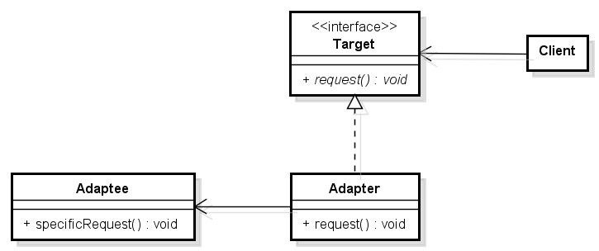
Design pattern: Adapter
System
The class/functionality we want to fit into our system

Slide 18


Slide 19
Agenda: Adapter design pattern
Concept of an adapter
Introduction to software adapter by a problem
Defining the adapter pattern
Common use in semester project, database
Adapting a List to a Queue, for the assignment
Further reading
At 10:15 we’ll do the Proxy

Slide 20

Example
System
Notes:
Your system wants to store stuff in a file

Slide 21

Example
System
<<interface>>
ICustomerData
+ addCustomer(c : Customer) : void
+ updateCustomer(c : Customer) : void
+ deleteCustomer(c : Customer) : void
+ getCustomer(id : int) : Customer
CustomerFileStorage
+ CustomerFileStorage()
Notes:
We can apply the adapter pattern, so now the system just knows about an interface, which promises some functionality. The CustomerFileStorage class is the responsible for providing said functionality though file storage.

Slide 22
Example
System
Target
<<interface>>
ICustomerData
+ addCustomer(c : Customer) : void
+ updateCustomer(c : Customer) : void
+ deleteCustomer(c : Customer) : void
+ getCustomer(id : int) : Customer
Adaptee
Adapter
CustomerFileStorage
+ CustomerFileStorage()

Slide 23
Example
System
<<interface>>
ICustomerData
+ addCustomer(c : Customer) : void
+ updateCustomer(c : Customer) : void
+ deleteCustomer(c : Customer) : void
+ getCustomer(id : int) : Customer
Database
System knows Java. We need to translate to SQL
CustomerFileStorage
+ CustomerFileStorage()
Notes:
Swapping out with a database

Slide 24
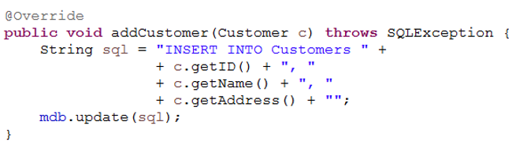
Example
System
<<interface>>
ICustomerData
+ addCustomer(c : Customer) : void
+ updateCustomer(c : Customer) : void
+ deleteCustomer(c : Customer) : void
+ getCustomer(id : int) : Customer
Jar file
CustomerDB
CustomerDB “adapts” the database into the existing system
System expects interface.
Doesn’t match MyDatabase
Notes:
Swap out CustomerFileStorage with CustomerDB. Nothing in the rest of the system needs to be modified.

Slide 25
Example
System
<<interface>>
ICustomerData
+ addCustomer(c : Customer) : void
+ updateCustomer(c : Customer) : void
+ deleteCustomer(c : Customer) : void
+ getCustomer(id : int) : Customer
CustomerDB
{
CustomerDBTranslater
Translates from e.g. addCustomer(…) to update(…)
Notes:
Example of what the addCustomer method could look like. The CustomerDB is responsible for taking a Customer object, unwrapping the data, translating to sql, and inserting into the database.

Slide 26

I have now created a “bridge” between ICustomerData and Database with the class CustomerDBTranslater
This is the idea of the Adapter design pattern
CustomerDBTranslater
ICustomerData
Database

Slide 27


Slide 28
Agenda: Adapter design pattern
Concept of an adapter
Introduction to software adapter by a problem
Defining the adapter pattern
Common use in semester project, database
Adapting a List to a Queue, for the assignment
Further reading
At 10:15 we’ll do the Proxy

Slide 29
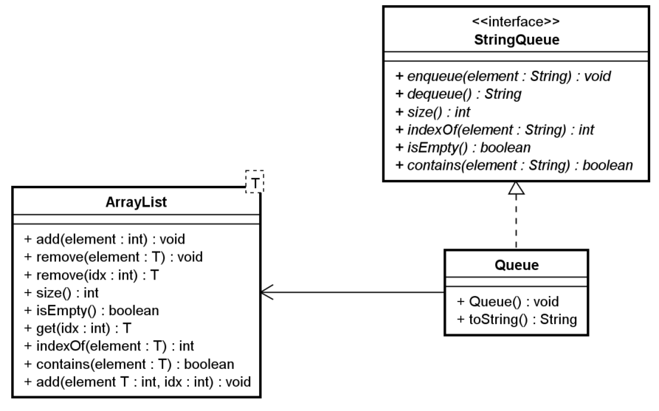
Implementing a Queue based on a List
System
Your system needs a Queue, but you don’t have one available

Slide 30
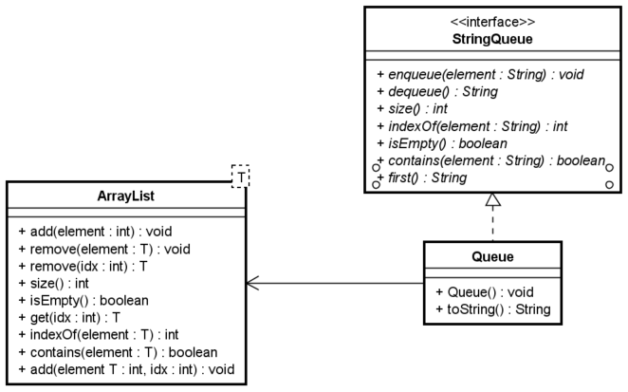
Implementing a Queue based on a List
System
Your system needs a Queue, but you don’t have one available
Target
Adaptee
Adapter

Slide 31
What to put into the Queue (the adapter)
We’re using an ArrayList to simulate the behavior of a Queue.
Each of the methods in the Queue class can use the existing functionality of the ArrayList

Slide 32
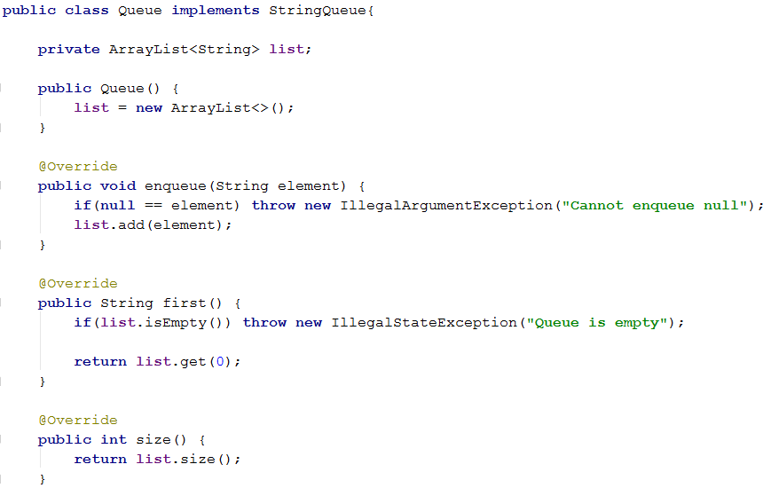
We’re borrowing the functionality of the ArrayList, to create our StringQueue

Slide 33


Slide 34
Agenda: Adapter design pattern
Concept of an adapter
Introduction to software adapter by a problem
Defining the adapter pattern
Common use in semester project, database
Adapting a List to a Queue, for the assignment
Further reading
At 10:15 we’ll do the Proxy

Slide 35
Data Access Object
Multiple adapters. When applying SOLID to the adapter pattern. See the uploaded video.
Inspiration for your SEP

Slide 36
We start again at 10:15!

Slide 37


